Slide 1
Needs Assessment of Out-of-School Time Programs in the District of Columbia
D.C. Policy Center
October 2017

Slide 2
About the D.C. Policy Center
Founded in 2016
Non-profit, non-partisan think tank
Local policy (D.C. and the metropolitan area)
Website: dcpolicycenter.org
Twitter: @dcpolicycenter

Slide 3
Overview of this report
/
What is the current landscape of out-of-school time (OST) programs in D.C.?
01
What is the current capacity?
02
Where are the gaps?
03
Further recommendations
04

Slide 4
Why do we care about out-of-school time programs?
What children and youth do when they are not in school matters when it comes to learning and life outcomes.
1
Increased demand from families as the District retains an increasing number of families.
2
Universal pre-K programs also boosted demand.
3
Positive social impacts justify subsidies.
4
Data matters in formulating a policy that allocates capacity and funding.
5

Slide 5
Findings: OST capacity
Afterschool capacity
- 33,400 children and youth attend regular afterschool programming in D.C.
- Includes 28,700 children in pre-K to 8th grade and 4,700 youth in grades 9-12
- Main providers are schools and community-based organizations (CBOs)
Summer school capacity
- 15,000 children and youth from pre-K3 to 12th grade participate in summer programs in D.C.
- Includes 4,700 entering pre-K3 to 8th grade, and 10,800 in grades 9 through 12
- Not counting MBSYEP participants, the number of summer program participants in grades 9 through 12 was less than 2,800)

Slide 6
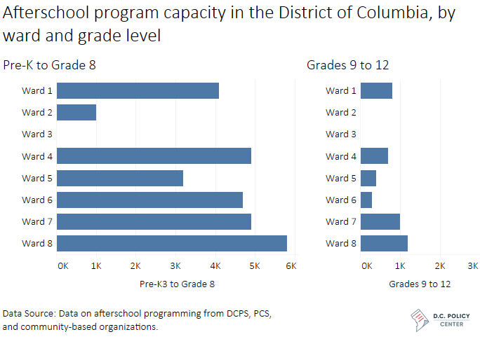

Slide 7
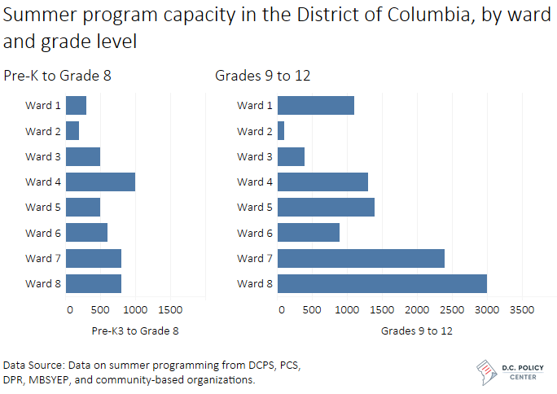

Slide 8
Four potential metrics of need for OST programs in D.C.
Metric | Definition | Estimated need
 |  | Pre-K to grade 8 | Grades 9-12 | Total
Universal Coverage | All children and youth in public schools (DCPS & DCPCS) | 66,300 | 17,100 | 83,400
130% of poverty line (broad income targeting) | Children and youth in public schools living in households under 130% of the poverty line | 40,200 | 10,400 | 50,500
“At risk” children & youth | Children and youth in public schools determined to be “at risk” for academic failure | 30,300 | 9,000 | 39,300
100% of poverty line (narrow income targeting) | Children and youth in public schools living in households below the poverty line | 16,900 | 4,100 | 21,000
Rows may not sum to totals due to rounding.

Slide 9
Estimated gaps in OST program capacity under four policy goals
 | Afterschool |  | Summer
 | Pre-K3 to grade 8 | Grades 9 to 12 | Pre-K3 to grade 8 | Grades 9 to 12
Universal coverage | -37,600 | -12,400 | -61,600 | -6,300
130 percent poverty | -11,400 | -5,600 | -35,500 | 400
"At risk" status | -1,600 | -4,300 | -25,600 | 1,700
100 percent poverty | 11,900 | 600 | -12,200 | 6,700

Slide 10
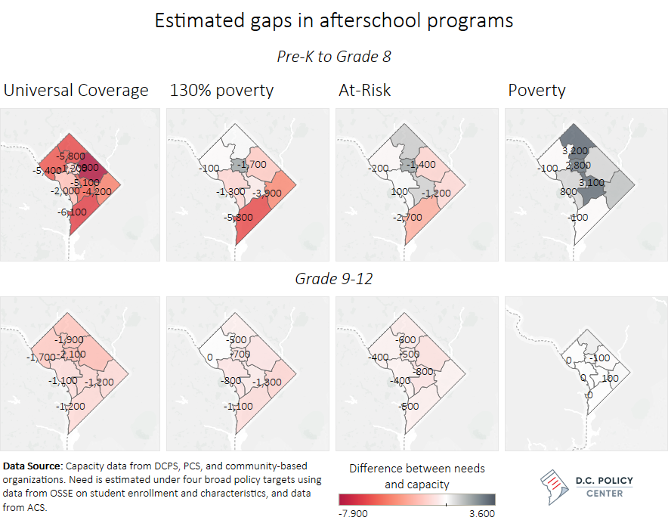

Slide 11
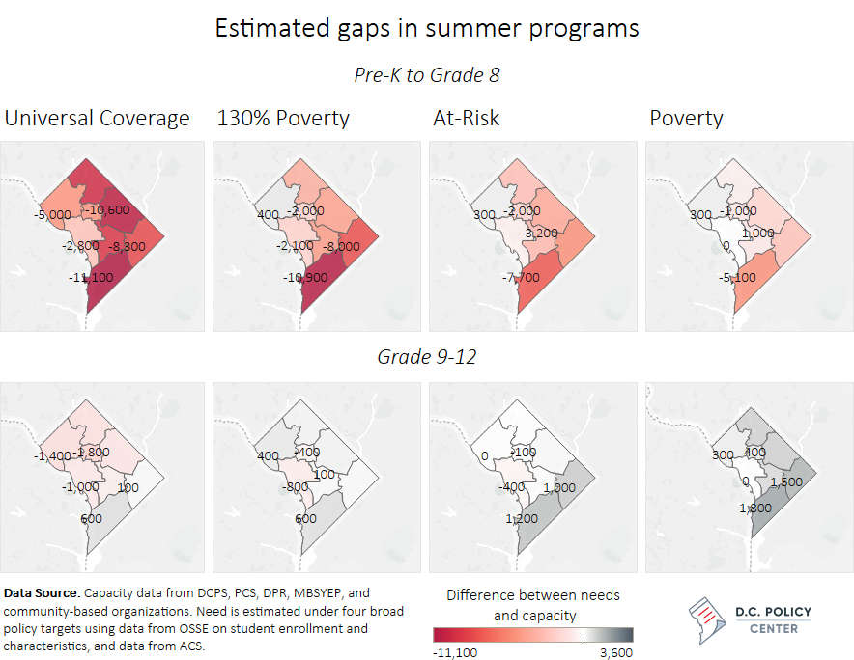

Slide 12
Parent and caregiver experiences
Finding up-to-date information about OST program offerings often difficult.
Affordable options are available, but limited.
Limited program hours and related transportation logistics can present challenges for families with young children.
Quality seen to vary by neighborhood.

Slide 13
Youth experiences (high school-age)
Sports and community service were most common non-school activities among our focus group participants
Schools, parents, and other OST programs are important information sources for youth
Interest in expanded program offerings (STEM, arts, pre-professional and career)

Slide 14
Recommendations: Three main areas
Data collection
Research on business models
Quality, effectiveness, and barriers to participation

Slide 15
I. Recommendations on data collection
/
Collect standardized data about OST programs provided by the District government and organizations receiving government funding.
01
Work with private foundations to expand OST program data collection to programs receiving foundational support.
02
Work closely with public charter schools to better understand how charter schools serve children, youth, and families through OST programs.
03
Collect information on OST programs operated by fully private providers that do not receive public funding.
04

Slide 16
II. Recommendations for additional research
/
Study
Study OST provider costs, financing, and pricing models.
Conduct
Conduct further research on challenges facing specific groups with additional barriers to academic success or other unique concerns.
Develop
Develop quality and effectiveness benchmarks.

Slide 17
III. Recommendations on quality and effectiveness based on focus group discussions
/
Work with providers to extend program hours to meet the needs of families.
01
Consider supervised transportation options for program serving younger children.
02
Increase the number/range of opportunities for older youth; more effectively engage in programming.
03
More fully engage schools and other nodes in children and youth’s informational networks as outreach partners.
04
Improve outreach and communication with families.
05

Slide 18
Data sources
U.S. Census and American Communities Survey (ACS) data compiled by Kids Count
OSSE school enrollment data
Program enrollment data from DCPS, public charter schools, D.C. government agencies, community-based organizations, UWNCA sub-grantees
Focus groups and qualitative questionnaires

Slide 19
Full report available at dcpolicycenter.org

